Slide 1
Middle Course Week
Sunday Review
The System – again!
  I P S G A
  System Review
Cornering
  Examiners are hot on this!

Slide 2
Observers
May appear to be wrong
  “It is okay to go at 85 on a motorway”
Usually due to context
  “... If the vehicle to your left starts to veer out and you need to escape”

Slide 3
Observers
May appear to differ
  “always signal at a roundabout”
  Context again
  “signal at this roundabout because...”
Not everything in Advanced Driving is defined
  Some things are a matter of opinion
  Eg. always push-pull vs. rotational steering
Ask/call/email the observer who said it!
And if there is a difference, embrace it: try both and see which suits you.

Slide 4
What do you wish you had known?
What did you like best?
What did you learn?
What was the worst bit?
Sunday Drives
Commentary?
What will you try and do before next week?
What would you (anonymously) tell the observer?

Slide 5
Video

Slide 6
Commentary
We all find it difficult
Ask each of your Observers to do one
There is no set style – choose your own
Try and do something without being asked – it may be enough

Slide 7
An aside on commentary
Originally “Cockpit Drill” for police to check car before going out
Often misunderstood to be POWER (external checks) – which you should have done before now if you are going to do them!
This is my car, know controls, got petrol
Checking seat belts, doors, mirrors
The weather today is… therefore …
The time is … therefore …
When we get out of the car park we will be on …
Checking Neutral and Handbrake, starting engine
Lights have all gone out
Checking firm pressure on brake pedal
If this was a hire car I would do a moving brake check
(Would you like me to do one?)
Fairly detailed for a couple of minutes
What is happening, what you are doing about it
Road signs, road layout, traffic lights etc, paint on road
How you are planning the drive
Much easier if you have been and had a look!
Now drop-back commentary
Saying something every couple of minutes
But this is on your terms, so you can do it all your own way, but the examiner may not then need to ask for a “proper” one.
“Pre-flight checks” … unnatural and quite hard, but…
… It is then easy to start talking as you move off with a fairly full narrative …
… which then drops-back to the highlights

Slide 8
‘The System’ - Use It Or Lose It
‘The System’ is Advanced Driving
Practice is essential
It is your Skill For Life
Use it
EVERY TIME YOU DRIVE
and
REFLECT ON YOUR PERFORMANCE
Use it when you are a passenger too!

Slide 9
Stands for?
IPSGA
You may well be asked to define it on the test!
You could get-in first

Slide 10
IPSGA
Information In
  Looking
  Listening
  Anticipating
  6th Sense

Slide 11

Information?
It is not just leaves.
What else do you have to prepare for?

Slide 12
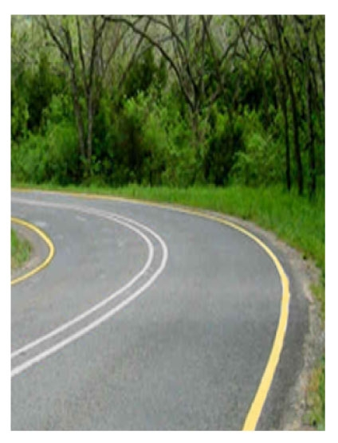
What would these tell us?

Slide 13

How do these bends differ?
What would you expect to be around the bend?

Slide 14
IPSGA
Processing the Information
  Forming the Driving Plan
Information Out
  Signal
  Brake Lights
  Positioning
  Hand Signal (not gesture!)
We are very sensitive to the subtle “body language” of cars, but most will not trust themselves to believe it. You can get massive credit on your test this way.

Slide 15
IPSGA
Requirements – eg roundabouts
Clear, definite indication of where we are going – may avoid use of signal
Advantageous – eg achieve/provide more visibility
Reducing the options for someone else to make a mistake

Slide 16
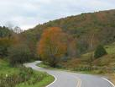
How would you drive this?

Slide 17
I P S G A
Remember that you do not necessarily change speed when you change gear – may be for power or control
SGA are linked together, and influence each other
Now
Hazard
Later
Speed now
Hazard speed
Target speed
Acc/Deceleration
Acc/Deceleration
Control now
Power now
Control at hazard
Power at hazard
Control later
Power later
Gears

Slide 18
IPSGA
Come off of dual carriageway, slowed to 30mph, still in 5th gear
Child on pavement – need 20mph
30mph urban area
30mph 5th
20mph
30mph
Control
Power
Decelerate/brake
2nd/3rd
Accelerate
3rd/4th
Block changes

Slide 19
IPSGA
60mph in country NSL in 5th gear
Corner NSL but needs 40mph
NSL country again
5th gear on country NSL?
60mph 5th
40mph
60mph
Power
Power
Decelerate/brake
3rd
Accelerate
4th/5th

Slide 20
IPSGA
30mph in urban area in 4th gear
Parked car but clear 30mph
Urban again
30mph 4th
30mph
30mph
Control
3rd
4th

Slide 21
Gear Phase
Get a reliable grip
Avoid overlap of gear changing and braking
  Finish braking before you change gear
Consider block-change rather than sequential
  Usually when you change down
Key thing is smoothness
To use a gearbox really well you must match your engine speed and road speed to an appropriate gear, ESPECIALLY for changing-down
Information
Position
Speed
Gears
Acceleration

Slide 22
Automatic Gearboxes
Advanced drivers using an automatic gearbox will still use ‘the system’ but, at the gear phase, an automatic may or may not select the correct gear for that place and moment !
Leaving it in D all day is wrong – you may end-up in the wrong gear
You often have to take control when:
  Going downhill to maintain control over speed
  Going uphill to prevent ‘hunting’ up & down between gears
  Before a bend to control engine power
  At large roundabouts to maintain balance
These could fail you the test
Not doing this could fail you the test

Slide 23
Manual vs. auto cars
There are a lot of prejudices around auto gearboxes (which were probably correct in the past). Nowadays automatics are not necessarily lower performance, less efficient, less sporty, or less enjoyable.
Example BMW:
0-62 time
  5.1 vs. 5.2 sec (not much in it)
MPG
  24.1 vs. 26.9 mpg (auto is better)
CO2
  279 vs. 249 g/km (auto is better)

Slide 24
Acceleration Phase
Might mean ‘deceleration’
Select an appropriate lower gear when at the right speed - before the hazard or bend
Maintain engine power to balance your car through or around a hazard
‘Balancing’ the car while cornering will maximise tyre grip and cause the least unfavourable weight distribution – resulting in maximum traction on unstressed tyres and, consequently, smoother steering
Generally, check all mirrors before and after applying acceleration
Maybe, do an over-the-shoulder check before changing position
Again, the key is smoothness
Information
Position
Speed
Gears
Acceleration

Slide 25
Car Balance
Driver and passenger comfort will be affected by the natural tendency of the car to pitch forwards or backwards or roll sideways when:
  Braking
  Decelerating
  Turning the steering wheel
  Accelerating
Cars with front-wheel, rear-wheel, or 4-wheel drive will each behave differently in the same circumstances – know what you are driving and find out what to expect
Refine your cornering skill to maintain car balance
Again, the key is smoothness
Balance is keeping the car flat and stable

Slide 26
‘The System’ - Flexibility
You should consider all the Phases of ‘The System’ on the approach to every hazard, BUT you may not need to use them all
Bear in mind that the WHOLE System must be considered on each occasion you approach a hazard because, in the real world, no two hazards will present identical dangers
This is where you pass or fail the test
This is where you add sparkle and polish
Naturally!
Safe Smooth Systematic
Notes:
The five phases of the system MUST be CONSIDERED at EVERY IDENTIFIED HAZARD, even though it may not be necessary to apply ALL the phases on each occasion.

Slide 27

That is ‘The System’ and it is all shown in greater detail in your manual

Slide 28

Section 1
The System Review
Skip

Slide 29
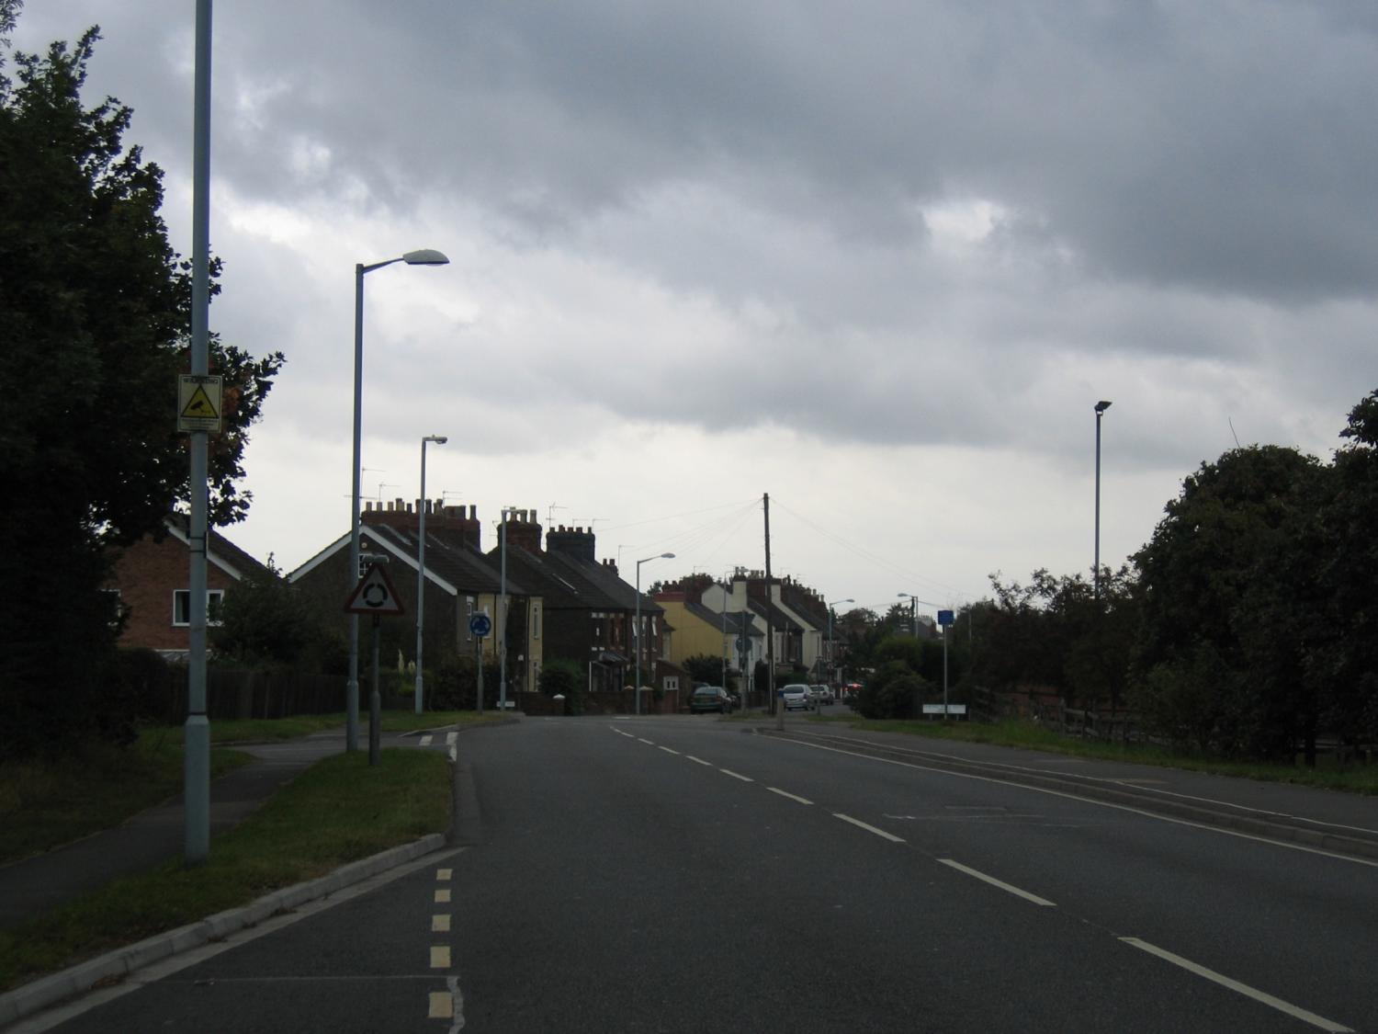
You will have several IPSGA processes happening at the same time for different hazards
It is your coordination of these, and your anticipation of distant hazards, that leads to smoothness
IPSGA
IPSGA
IPSGA
IPSGA

Slide 30
The Scenario
It is late Spring
It is a dull but dry day
We are driving at 30mph in a 30mph zone
We are in a silver BMW
It is a Thursday at 1600hrs
There are no vehicles behind us
There are no bits of aircraft falling from the sky
You may not know the relevance of all the information
If something is not causing you to change speed or direction then it is not relevant at the moment and does not need a commentary

Slide 31
INFORMATION
Information In → The Plan → Information Out
In:
Everything from the previous slide
We are passing a bus stop
There is a side road to the left
We are approaching a mini-roundabout where we want to turn right
Only parked or non-contending cars visible
Plan:
1600hrs, weekday, residential = school children – none visible but keep an eye out
Dull – not a hazard
Lots of visibility of the side road – not a hazard, but keep an eye on it
It’s a mini-roundabout so it will be a tight fit in a BMW
Probably 10mph
Out:
Nobody needs a signal [horn, arm signals, hazard flashers, brake lights…] yet
POSITION
Keep away from the side road
Approach on the left so we make a better attempt to go round
SPEED
30mph down to 10mph
GEAR
Stay in whatever we have now until end of braking, then 2nd
(maybe need to depress the clutch ~ “Declutch”)
ACCELERATION
Decelerate
Light brake
Heavy brake
Light brake – arrive going at 10mph

Slide 32
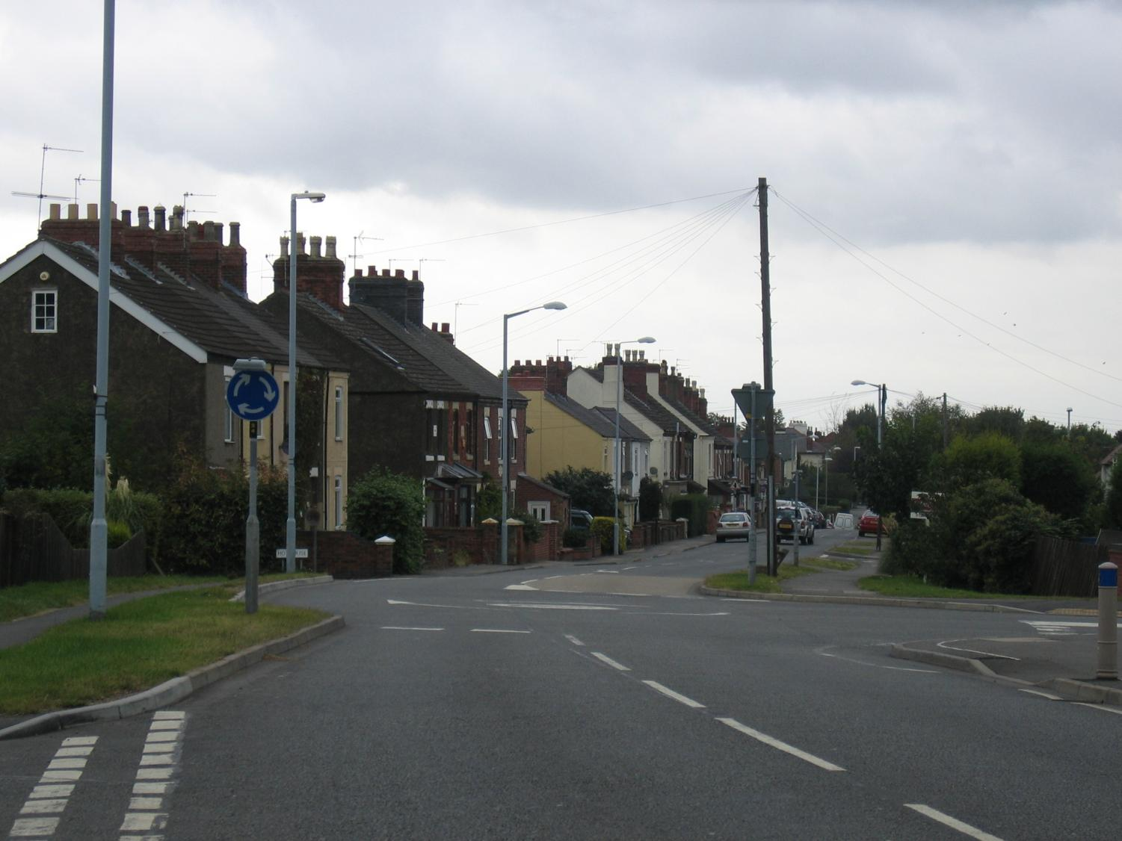
In:
No school children
We are past the side road
We are close to a mini-roundabout where we want to turn right
No other relevant cars visible
It is a tight roundabout with a nasty jutting kerb
Plan:
Go round as best we can
Out:
Nobody needs a signal (yet)
INFORMATION
Information In → The Plan → Information Out
POSITION
Miss the kerb
Attempt to go round
SPEED
13 down to 10
GEAR
Stay in whatever we have now until end of braking, then 2nd
(maybe need to declutch)
ACCELERATION
Light brake

Slide 33
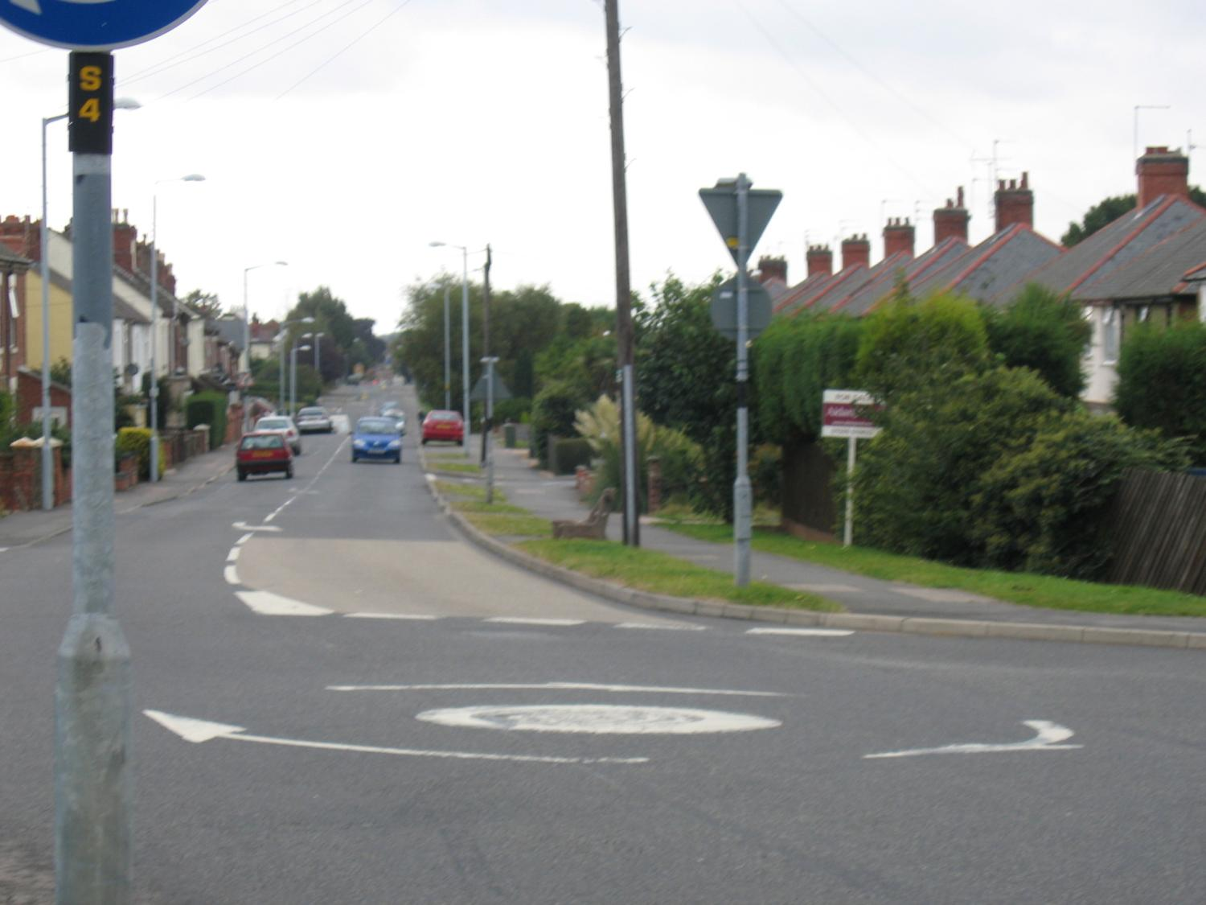
In:
No school children
We are at the mini-roundabout where we want to turn right
Oncoming car – no contention
It is a tight roundabout with a nasty jutting kerb
Plan:
Go round as best we can
Out:
Signal NOW
INFORMATION
Information In → The Plan → Information Out
POSITION
Miss the kerb
Attempt to go round
SPEED
10mph
GEAR
Change to 2nd NOW
ACCELERATION
Finished braking
Gentle power to balance car

Slide 34
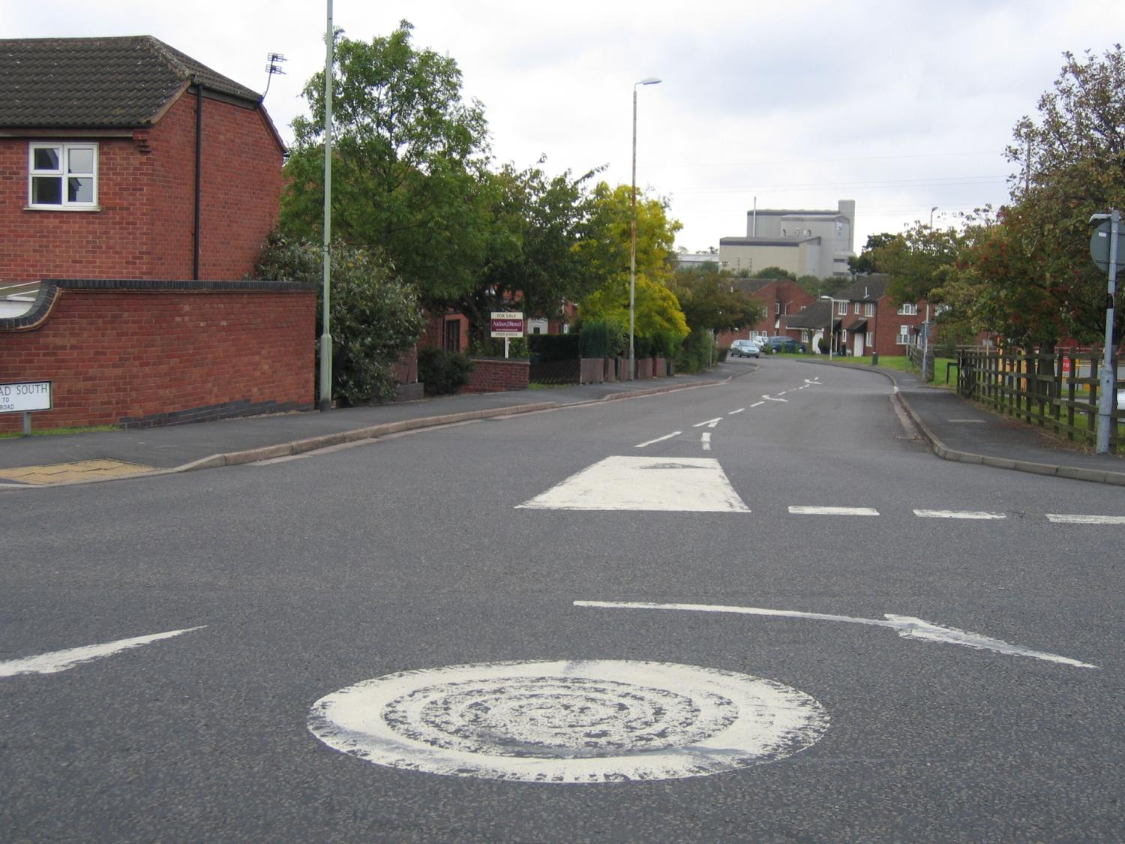
In:
No school children
We are looking right from the mini-roundabout where we are going
Oncoming car – no contention
Entrance to the right
Plan:
Continue round
Watch the side road
Accelerate
Out:
Stop signalling (he has seen it now, and the new guy does not need it)
INFORMATION
Information In → The Plan → Information Out
POSITION
Try to miss the (very small) spot
Return to standard road position
SPEED
10mph up to 30mph
GEAR
Change up when possible
ACCELERATION
Gentle power to apex
Then accelerate

Slide 35
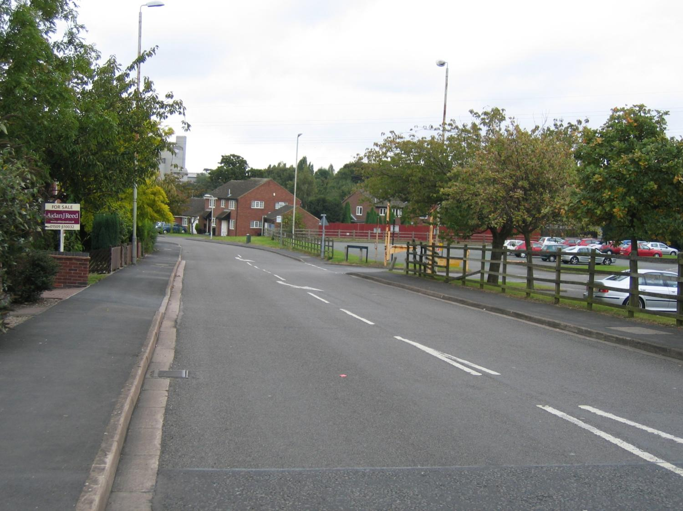
In:
No school children
Entrance to the right has excellent visibility – no hazard
We have got a bend coming up
Plan:
Continue... No changes yet
Prepare for the bend
Looks like a 25mph
Out:
None
INFORMATION
Information In → The Plan → Information Out
POSITION
Standard road position
Then move to right for visibility round bend
SPEED
Still going up to 30mph
Then down to 25mph?
GEAR
Corner needs 3rd
Change from 2 → 3 / Maybe 2 → 4 →3
NOT 2 → 3 → 4 →3
ACCELERATION
Accelerate up to 30mph
Decelerate to 25mph
Ease off... probably no braking needed

Slide 36
Development Of Our Plan
Stage 1
  1600, weekday, residential = school children – none visible but keep an eye out
  Dull, not a hazard
  Lots of visibility of the side road – not a hazard, but keep an eye on it
  It’s a mini-roundabout so it will be a tight fit in a BMW
  Probably 10mph
Stage 2
  Go round as best we can
Stage 3
  Continue round
  Watch the side road
  Accelerate
Stage 4
  Continue
  Prepare for the bend
  Looks like a 25mph
We did some fixed stages
In reality it is a constantly changing plan
It unifies the separate small IPSGA’s

Slide 37
The Plan Develops…
Stage 1
  1600, weekday, residential = school children – none visible but keep an eye out
  Dull, not a hazard
  Lots of visibility of the side road – not a hazard, but keep an eye on it
  It’s a mini-roundabout so it will be a tight fit in a BMW
  Probably 10mph
Stage 2
  Go round as best we can
Stage 3
  Continue round
  Watch the side road
  Accelerate
Stage 4
  Continue
  Prepare for the bend
  Looks like a 25mph
The highlighted sections are the key elements that we have to deal with

Slide 38
And Creates The Commentary
May need to set the scene:
  Dull day, residential, school kids
Then comment on the key points of information and our plan of action:
  I am keeping away from the side road to the left and slowing for the tight mini roundabout ahead
  Indicating for the oncoming car
  Watching the entrance to the right and positioning for the bend ahead to get maximum visibility
Worse habit – Say nothing
Bad habit – Say you are indicating
Good habit - Say why you are indicating
Better habit – Say who you are indicating for

Slide 39
Any Questions?
Notes:
39

Slide 40
Section 2
Cornering Introduction
Skip

Slide 41
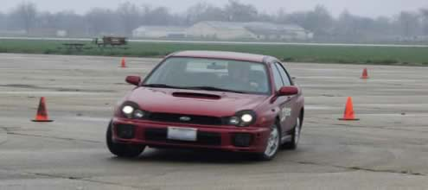
What Happens When A Car Corners?
Forces act on the car and its contents, and everything moves – or tries to move – to the outside of the corner

Slide 42
Cornering Forces
Car moving forwards at a fixed speed – no forces act on the car or its contents. However, everything has momentum.
Any change in speed or direction causes forces to act.
Momentum will then act on the car and its contents, and cause them to try and move in the original direction at the original speed.

Slide 43
Cornering Forces
Momentum
We now turn the wheel.
This creates a cornering force on the car body – but not on people and contents since they are not connected to the car.
Cornering force
The car wants to carry straight-on because of momentum, but now has a sideways force too. Usually it starts to turn.
People and contents carry straight-on because of momentum, whilst car turns. (Appears that they move to the outside of the corner.)

Slide 44
Cornering Forces
The size of the cornering force depends on:
  Amount we turn the wheel
  Grip between tyre and road
    Leaves
    Ice
    Water
    Mud
    etc
  Angle of road – properly called Camber
See later

Slide 45
Cornering Forces
If cornering force is bigger than momentum then the car will turn
The amount it turns will depend on how much bigger
If momentum is bigger than the cornering force then you fall-off of the corner into the ditch

Slide 46
Cornering Forces
Going fast = large momentum
Dodgy surface/tyres = small cornering force
Disaster!

Slide 47
Cornering Forces
Going more slowly = less momentum
Good surface/tyres = large cornering force
Success!

Slide 48
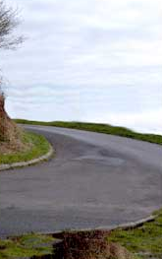
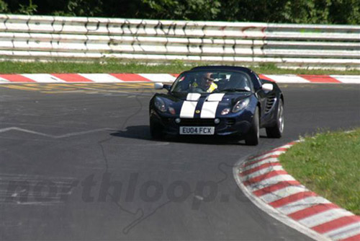
Camber
This is an “Adverse Camber”
The angle of the road pushes the car to the outside of the corner – therefore reducing the cornering force
Therefore you need to travel much more slowly to reduce momentum thus avoid falling-off
This is a banked corner
The angle of the road pushes the car to the inside of the corner – therefore
increasing the cornering force
Therefore you can travel faster (more momentum) without falling-off

Slide 49

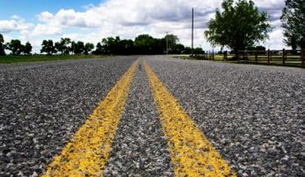
Deliberate Camber
Roads generally have a slight camber to make water fall to the drains
Road in the UK with outwards facing camber (called Crown Camber)
Road in the US with inwards facing camber to the central drain

Slide 50
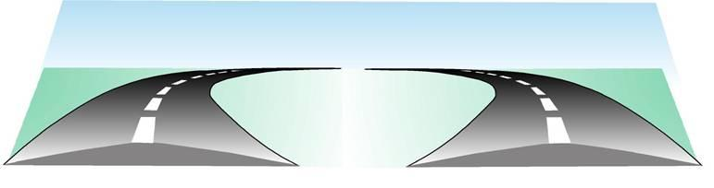
Crown Camber on corners
On a right hand bend the Camber is adverse and increases the cornering effects therefore you must go
more slowly
On a left hand bend the Camber decreases the cornering effects therefore you can go more quickly
On a right hand bend the Camber is adverse and decreases the cornering effects – therefore you must go more slowly
On a left hand bend the Camber increases the cornering effects – therefore you can go more quickly
Reproduced by permission from The Stationery Office Ltd from Roadcraft published on behalf of the Police Foundation

Slide 51
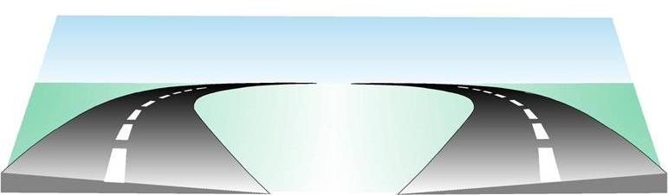
Super Elevation
In the UK, corners are normally built with Super-Elevation instead of Crown Camber
This increases the cornering effects whichever way you go around
But the examiner will expect you to be assessing each corner
Reproduced by permission from The Stationery Office Ltd from Roadcraft published on behalf of the Police Foundation

Slide 52
Therefore…
The Camber, the road surface, and your tyres are fixed – you can only alter your speed
So on the approach to a corner you need to set your speed to match:
  Camber
  Conditions
In order to get around comfortably without falling-off

Slide 53
Remember
If necessary, reduce speed by braking, when your vehicle is still in a straight line
Your speed through the corner should allow you to stop safely in the distance you can see to be clear
At the appropriate speed, select the appropriate gear – before the corner!
Check the road surface for potholes, rough patches, drains etc which may influence your line through the corner
Steer smoothly into the corner – harsh steering will put extra load on your tyres and may cause a skid if friction is poor
Balance, Smoothness

Slide 54
Then
Accelerate gently through the corner to maintain speed
When your view opens-up (see later section) and you start to straighten your vehicle, start to accelerate gently to increase speed
Acceleration should be tailored to road conditions and should remain gentle until the road is straight
Early or excessive acceleration could cause your vehicle to run wide or skid
Generally, do not brake on a corner

Slide 55
Any Questions?
Notes:
55

Slide 56
Section 3
Advanced Cornering
Skip

Slide 57
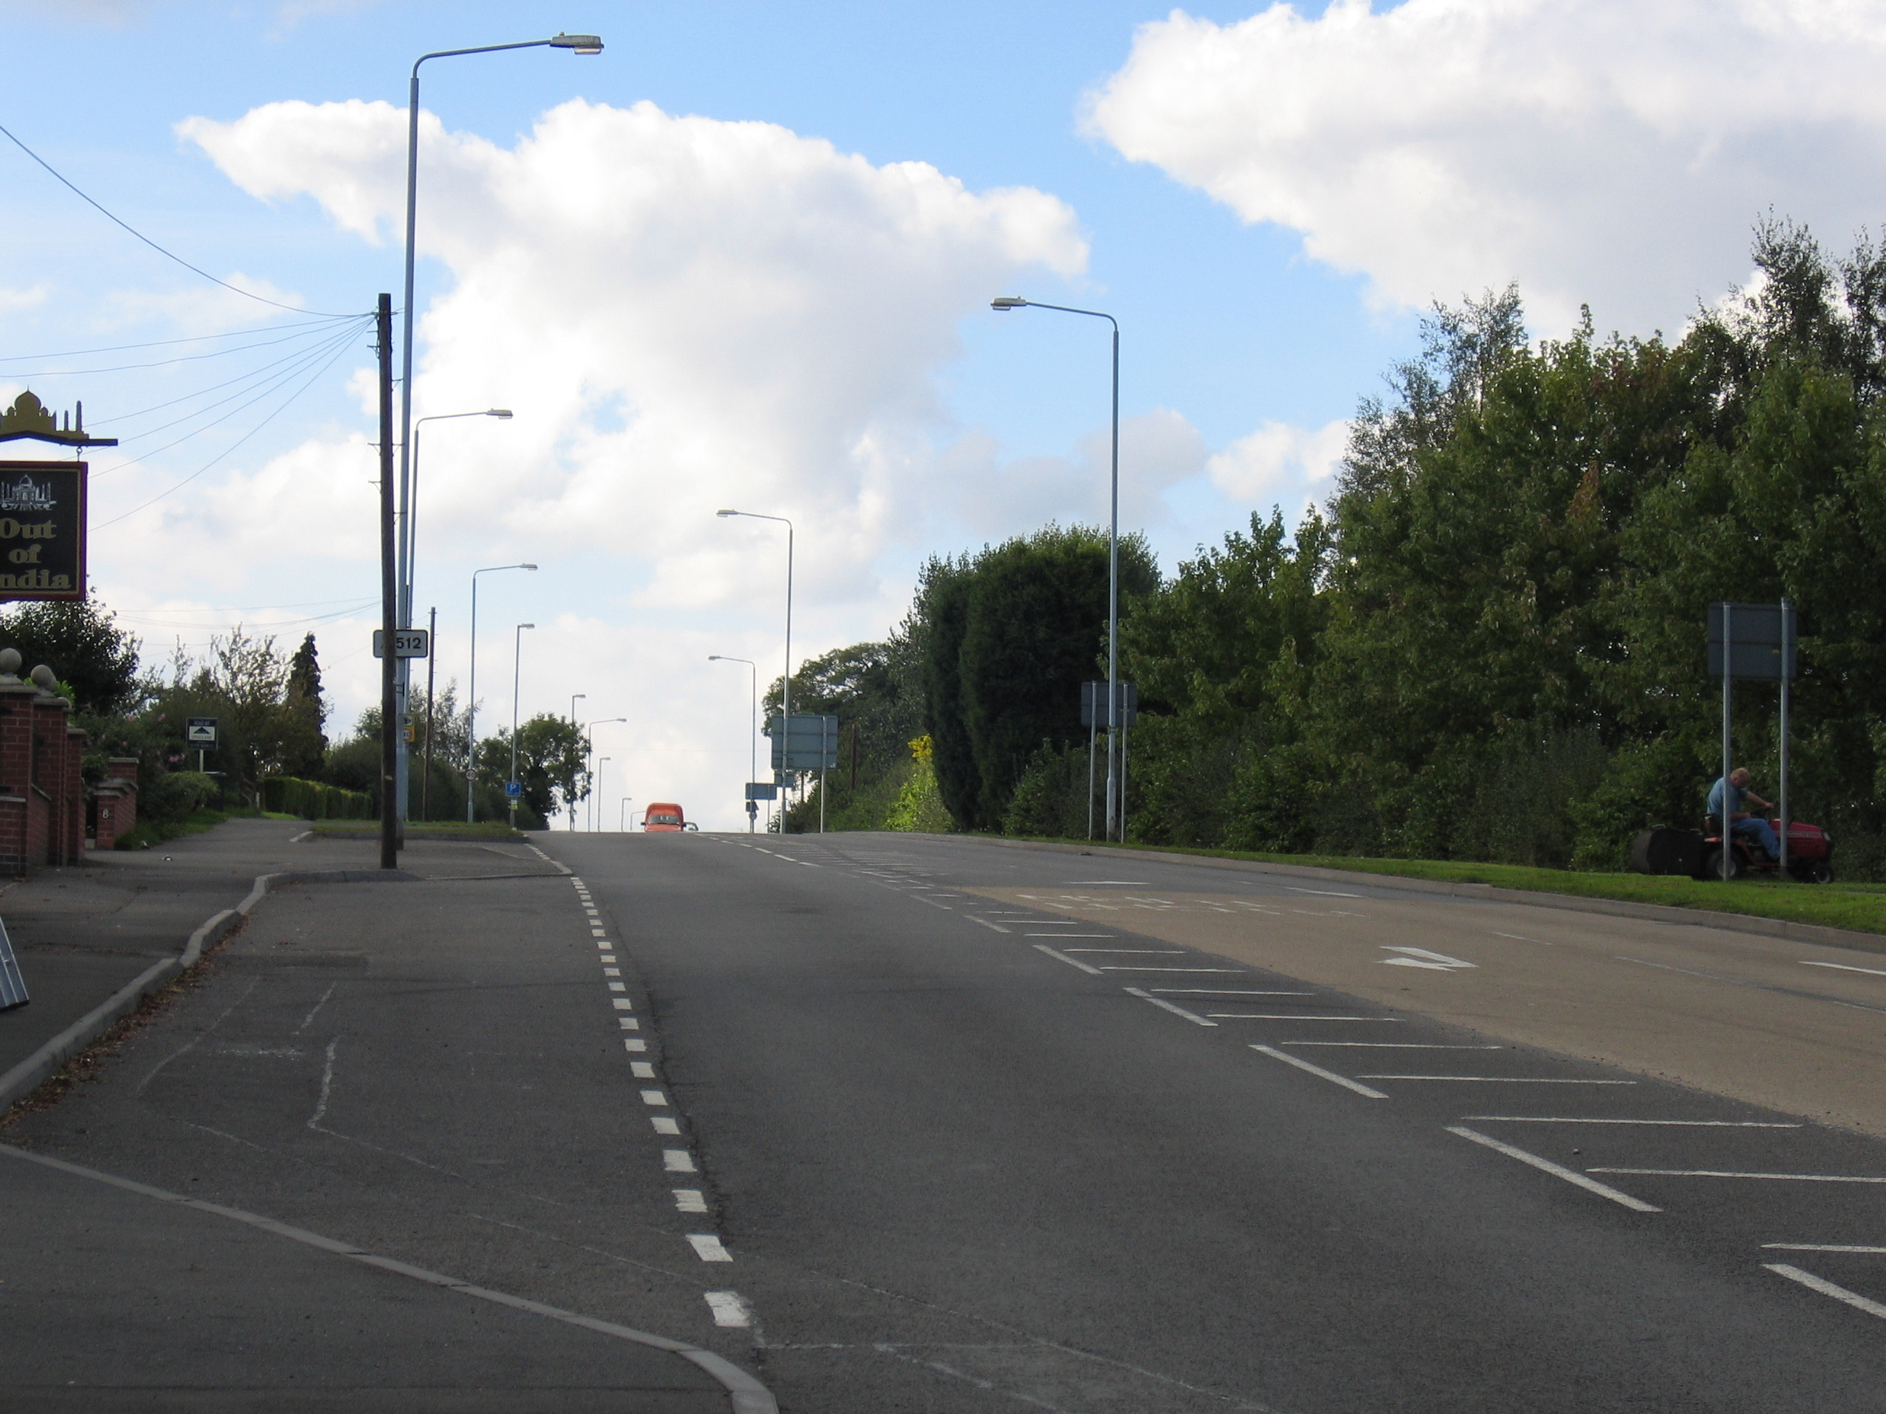
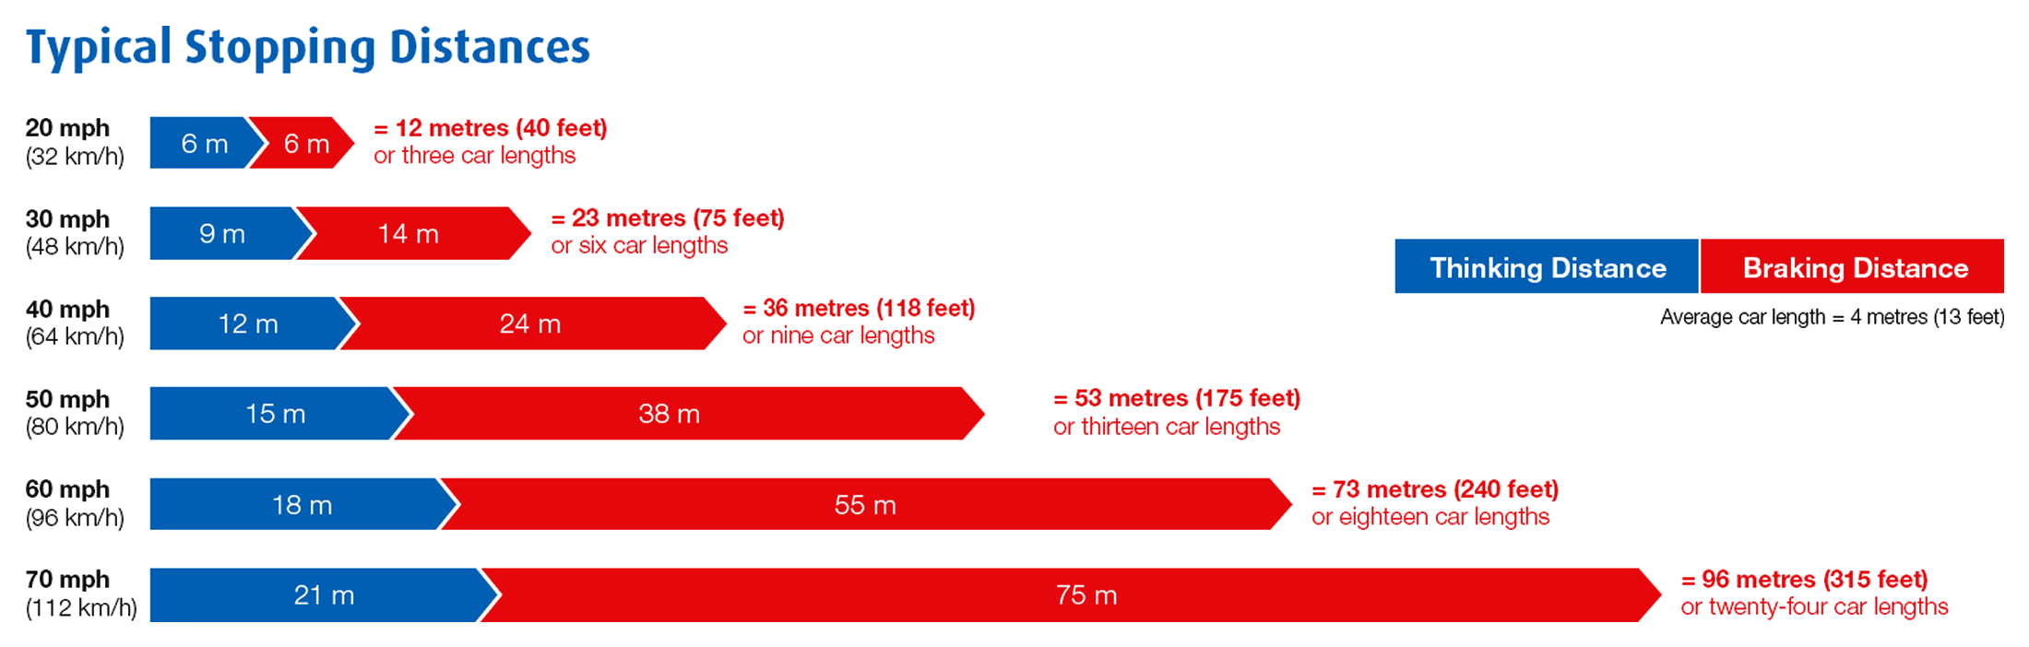
The limit point is the furthest point of uninterrupted road we can see.
- Continuous road from us to the limit point
40
If it is 100ft from us to the limit point, how fast should we be going?
126 ... Drive at a speed that will allow you to stop well within the distance you can see to be clear…
What happens over the hill? (Anticipation)

Slide 58
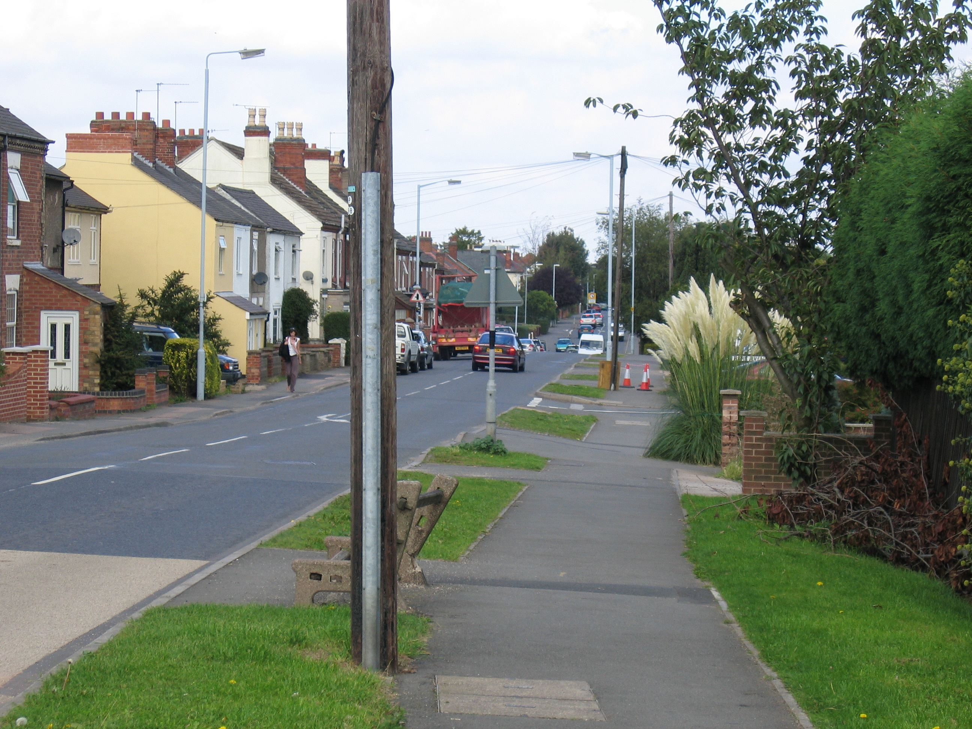
Or here
Hazards?
What do we have to worry about,
and in what order?

Slide 59
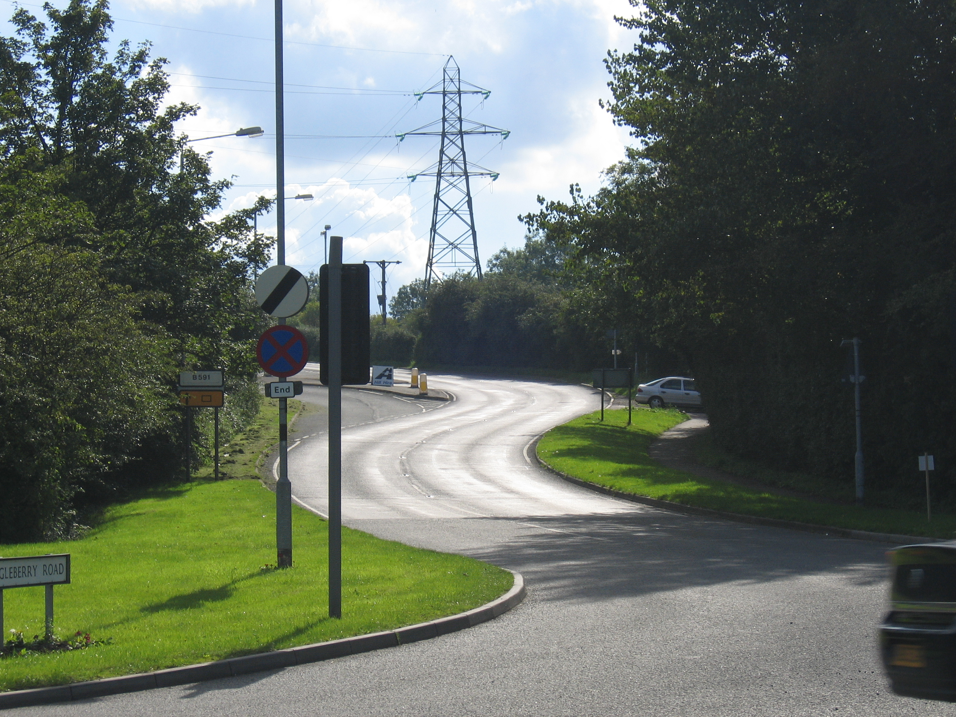
Hazards?
Plan? PSGA?

Slide 60
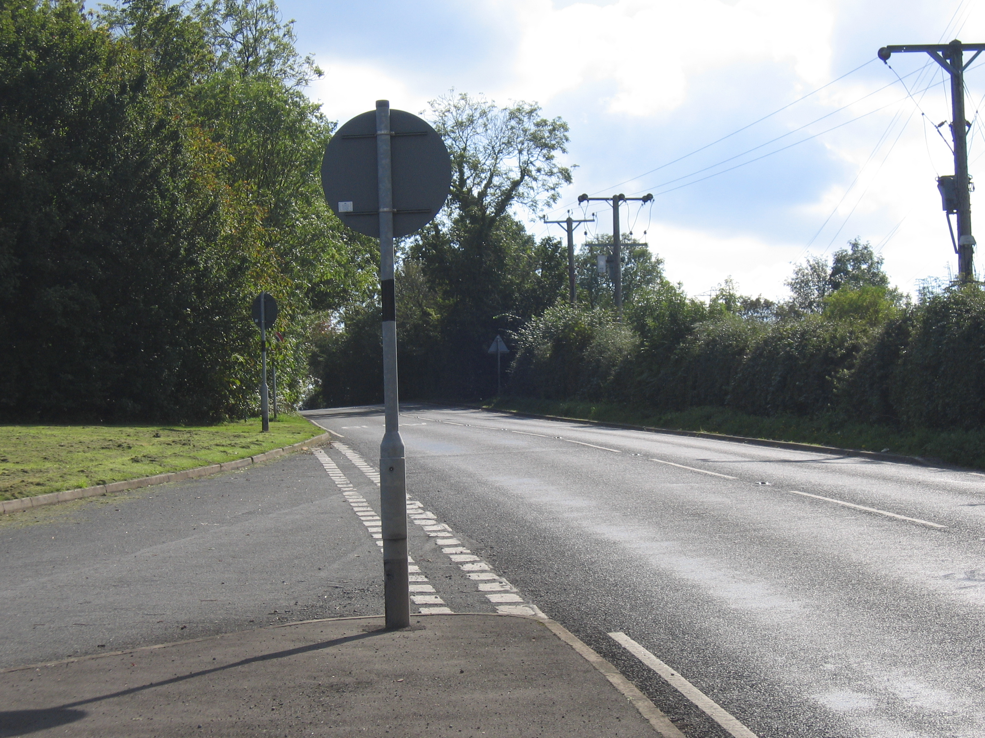
So the limit point is just to the left of this gap in the trees

Slide 61
We are going to drive towards the corner and see how the limit point changes

Slide 62
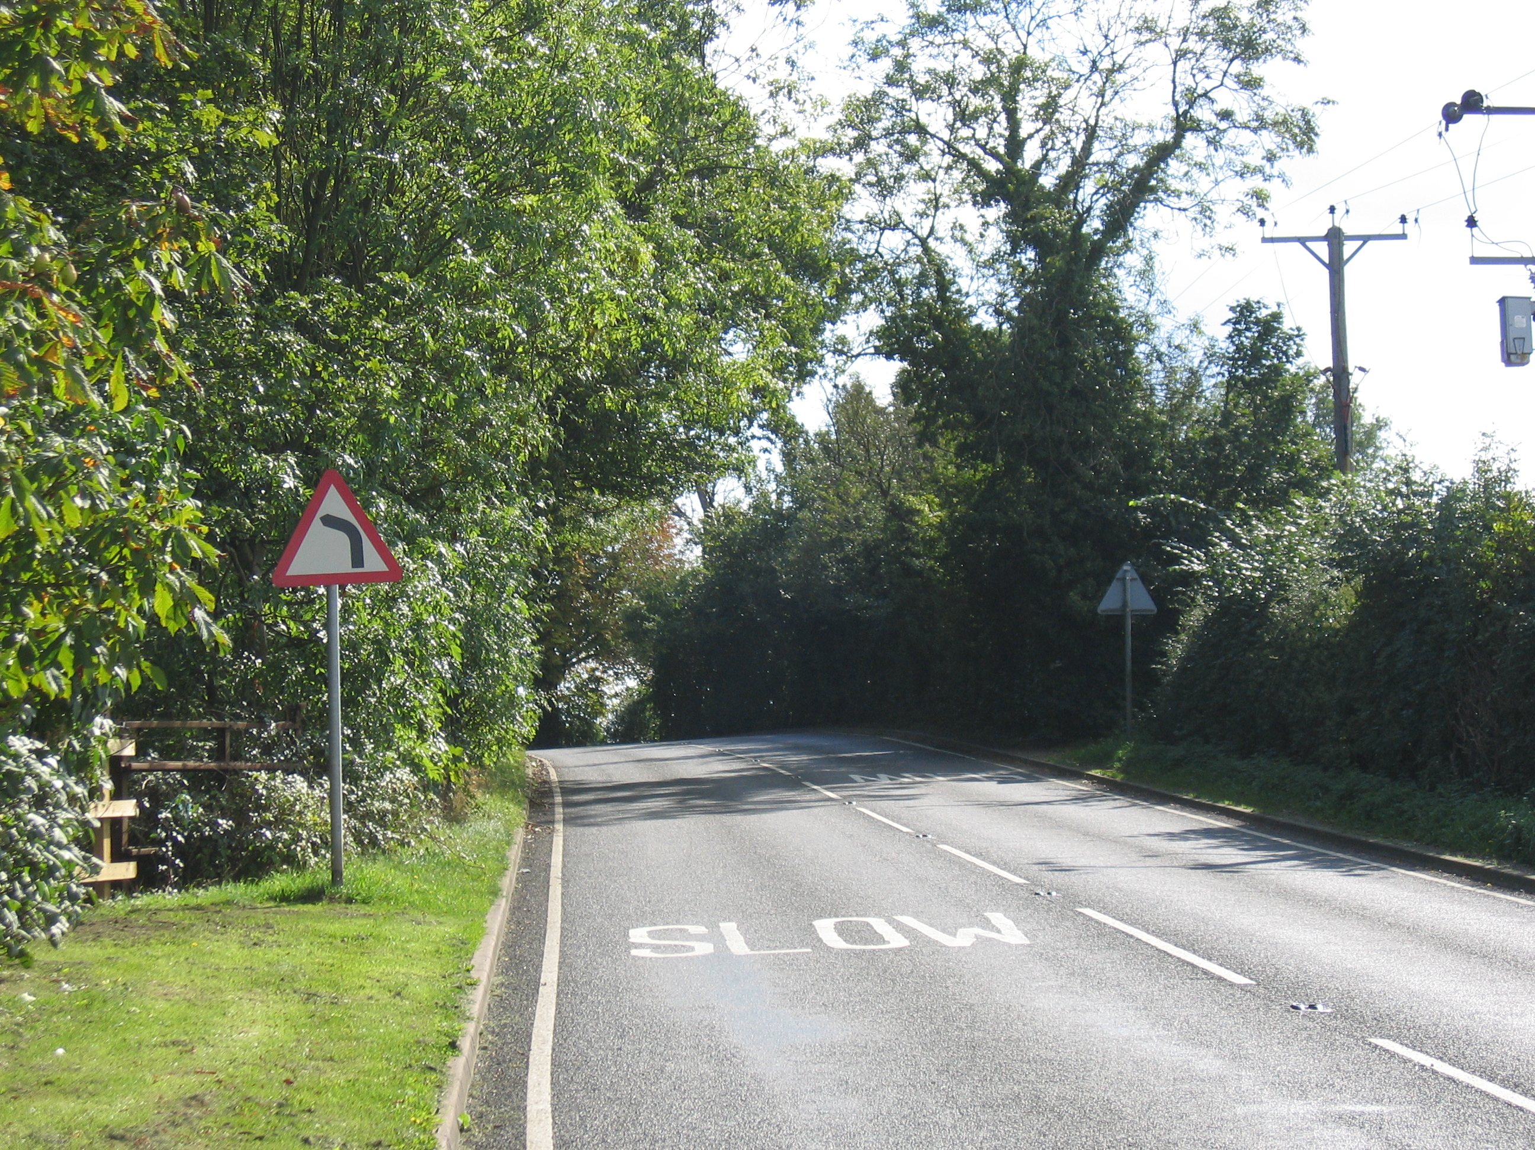
How fast?
75 feet?
Which gear are you in?

Slide 63
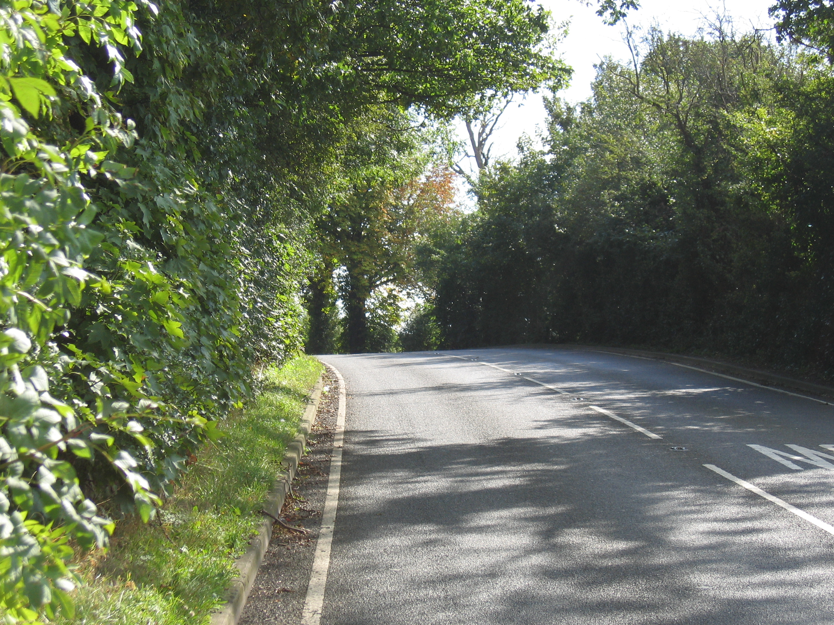

Slide 64
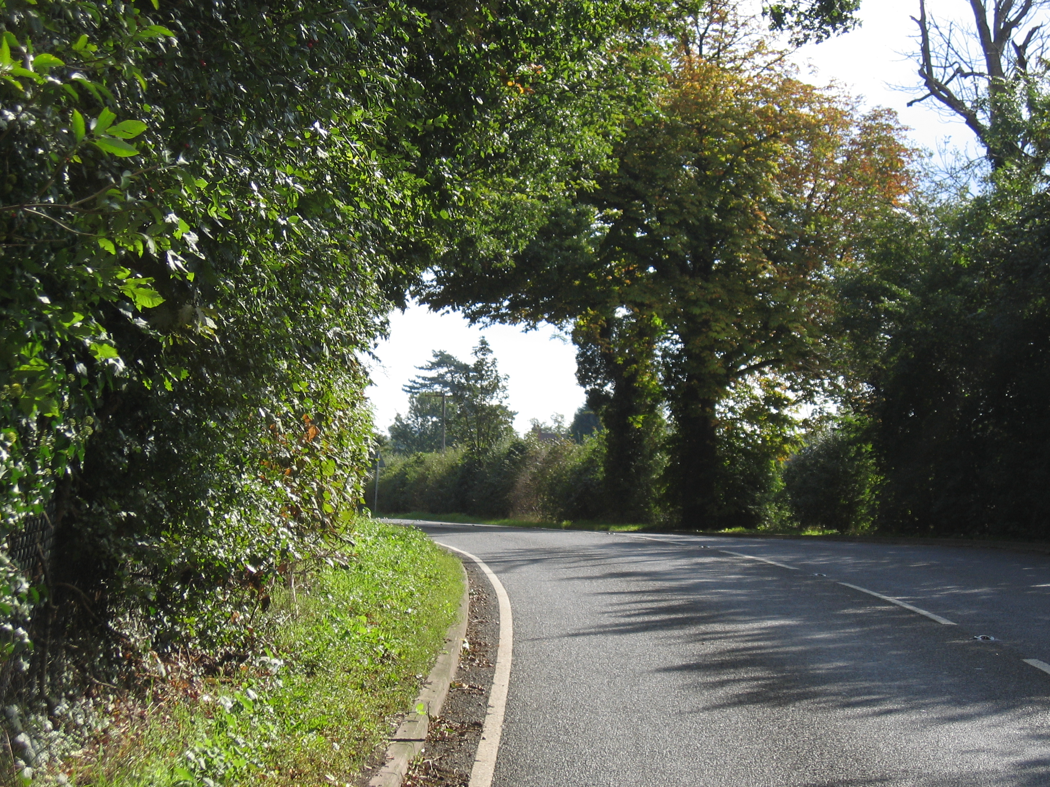
So all of a sudden the limit point accelerates away, and we can accelerate with it

Slide 65
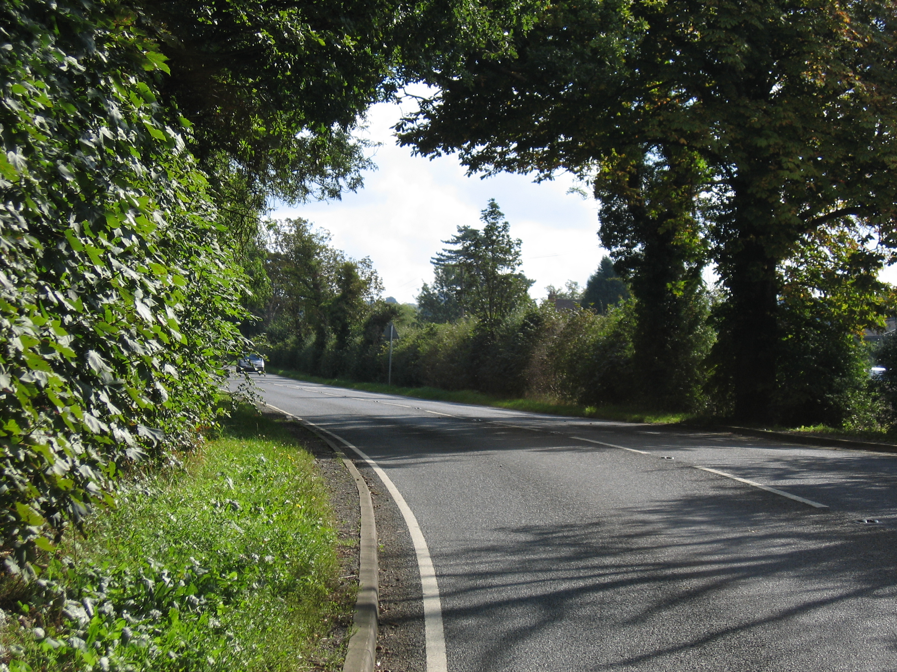

Slide 66
So…
As you approach the corner
  Limit point moves slightly
  Need to keep an eye on distance
  Need to match speed to where limit point is
Suddenly the limit point jumps away
  We can start to accelerate
  Limit point will accelerate, so we can too
Cannot change gear mid-corner
  Need to assess corner in advance
  Slow down before the corner and engage right gear

Slide 67
We start again, this time we are going to compare the view from the left of the lane to the view from the right

Slide 68
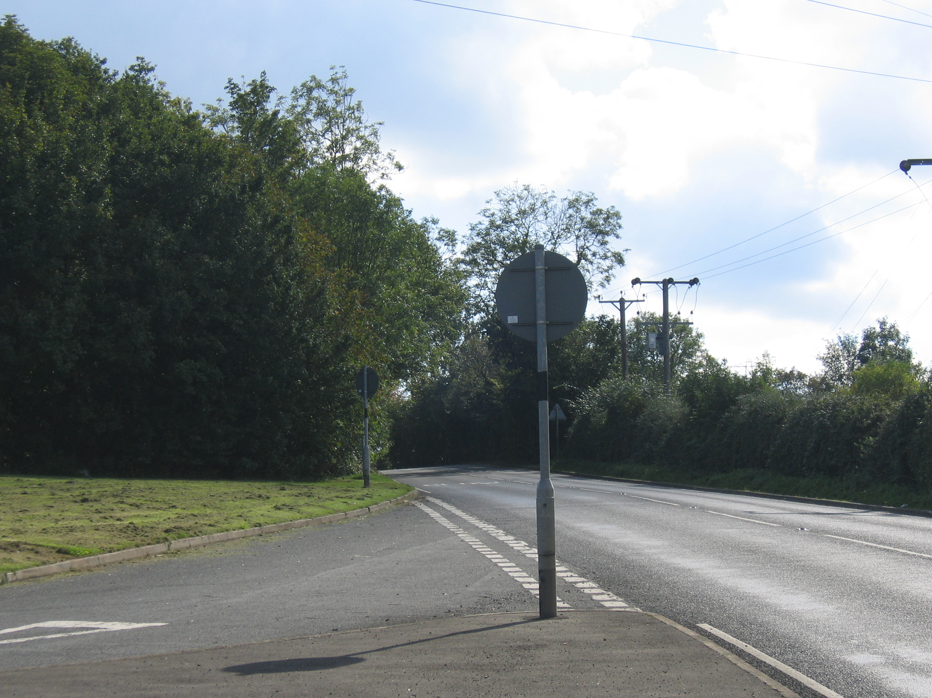
1 Left

Slide 69
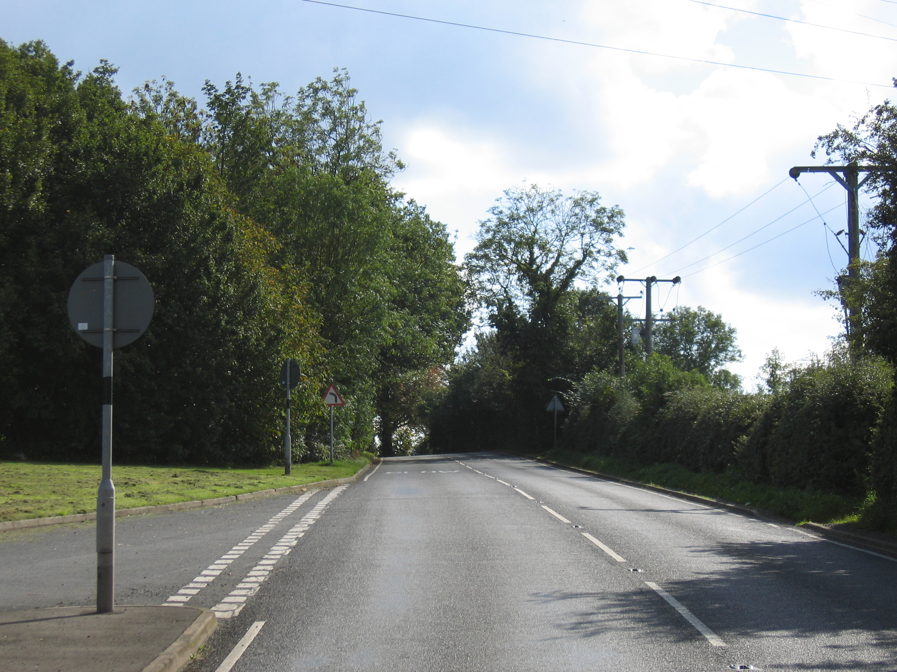
1 Right
By being on the right (the outside of the corner) we can see further into the corner, the limit point is further away, and we can make more progress.

Slide 70
2 Left

Slide 71
2 Left

Slide 72
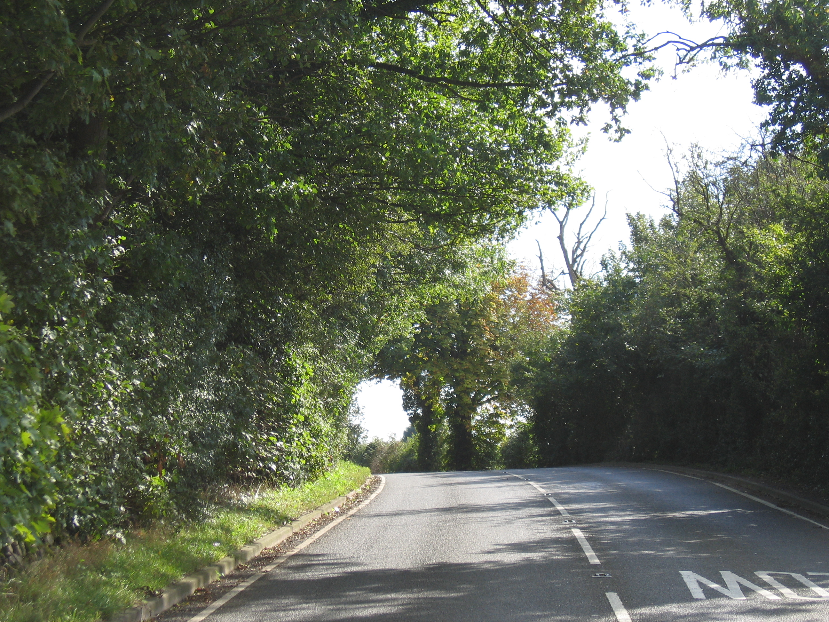
2 Right

Slide 73
3 Left
Limit point moving slightly, but not enough to accelerate

Slide 74
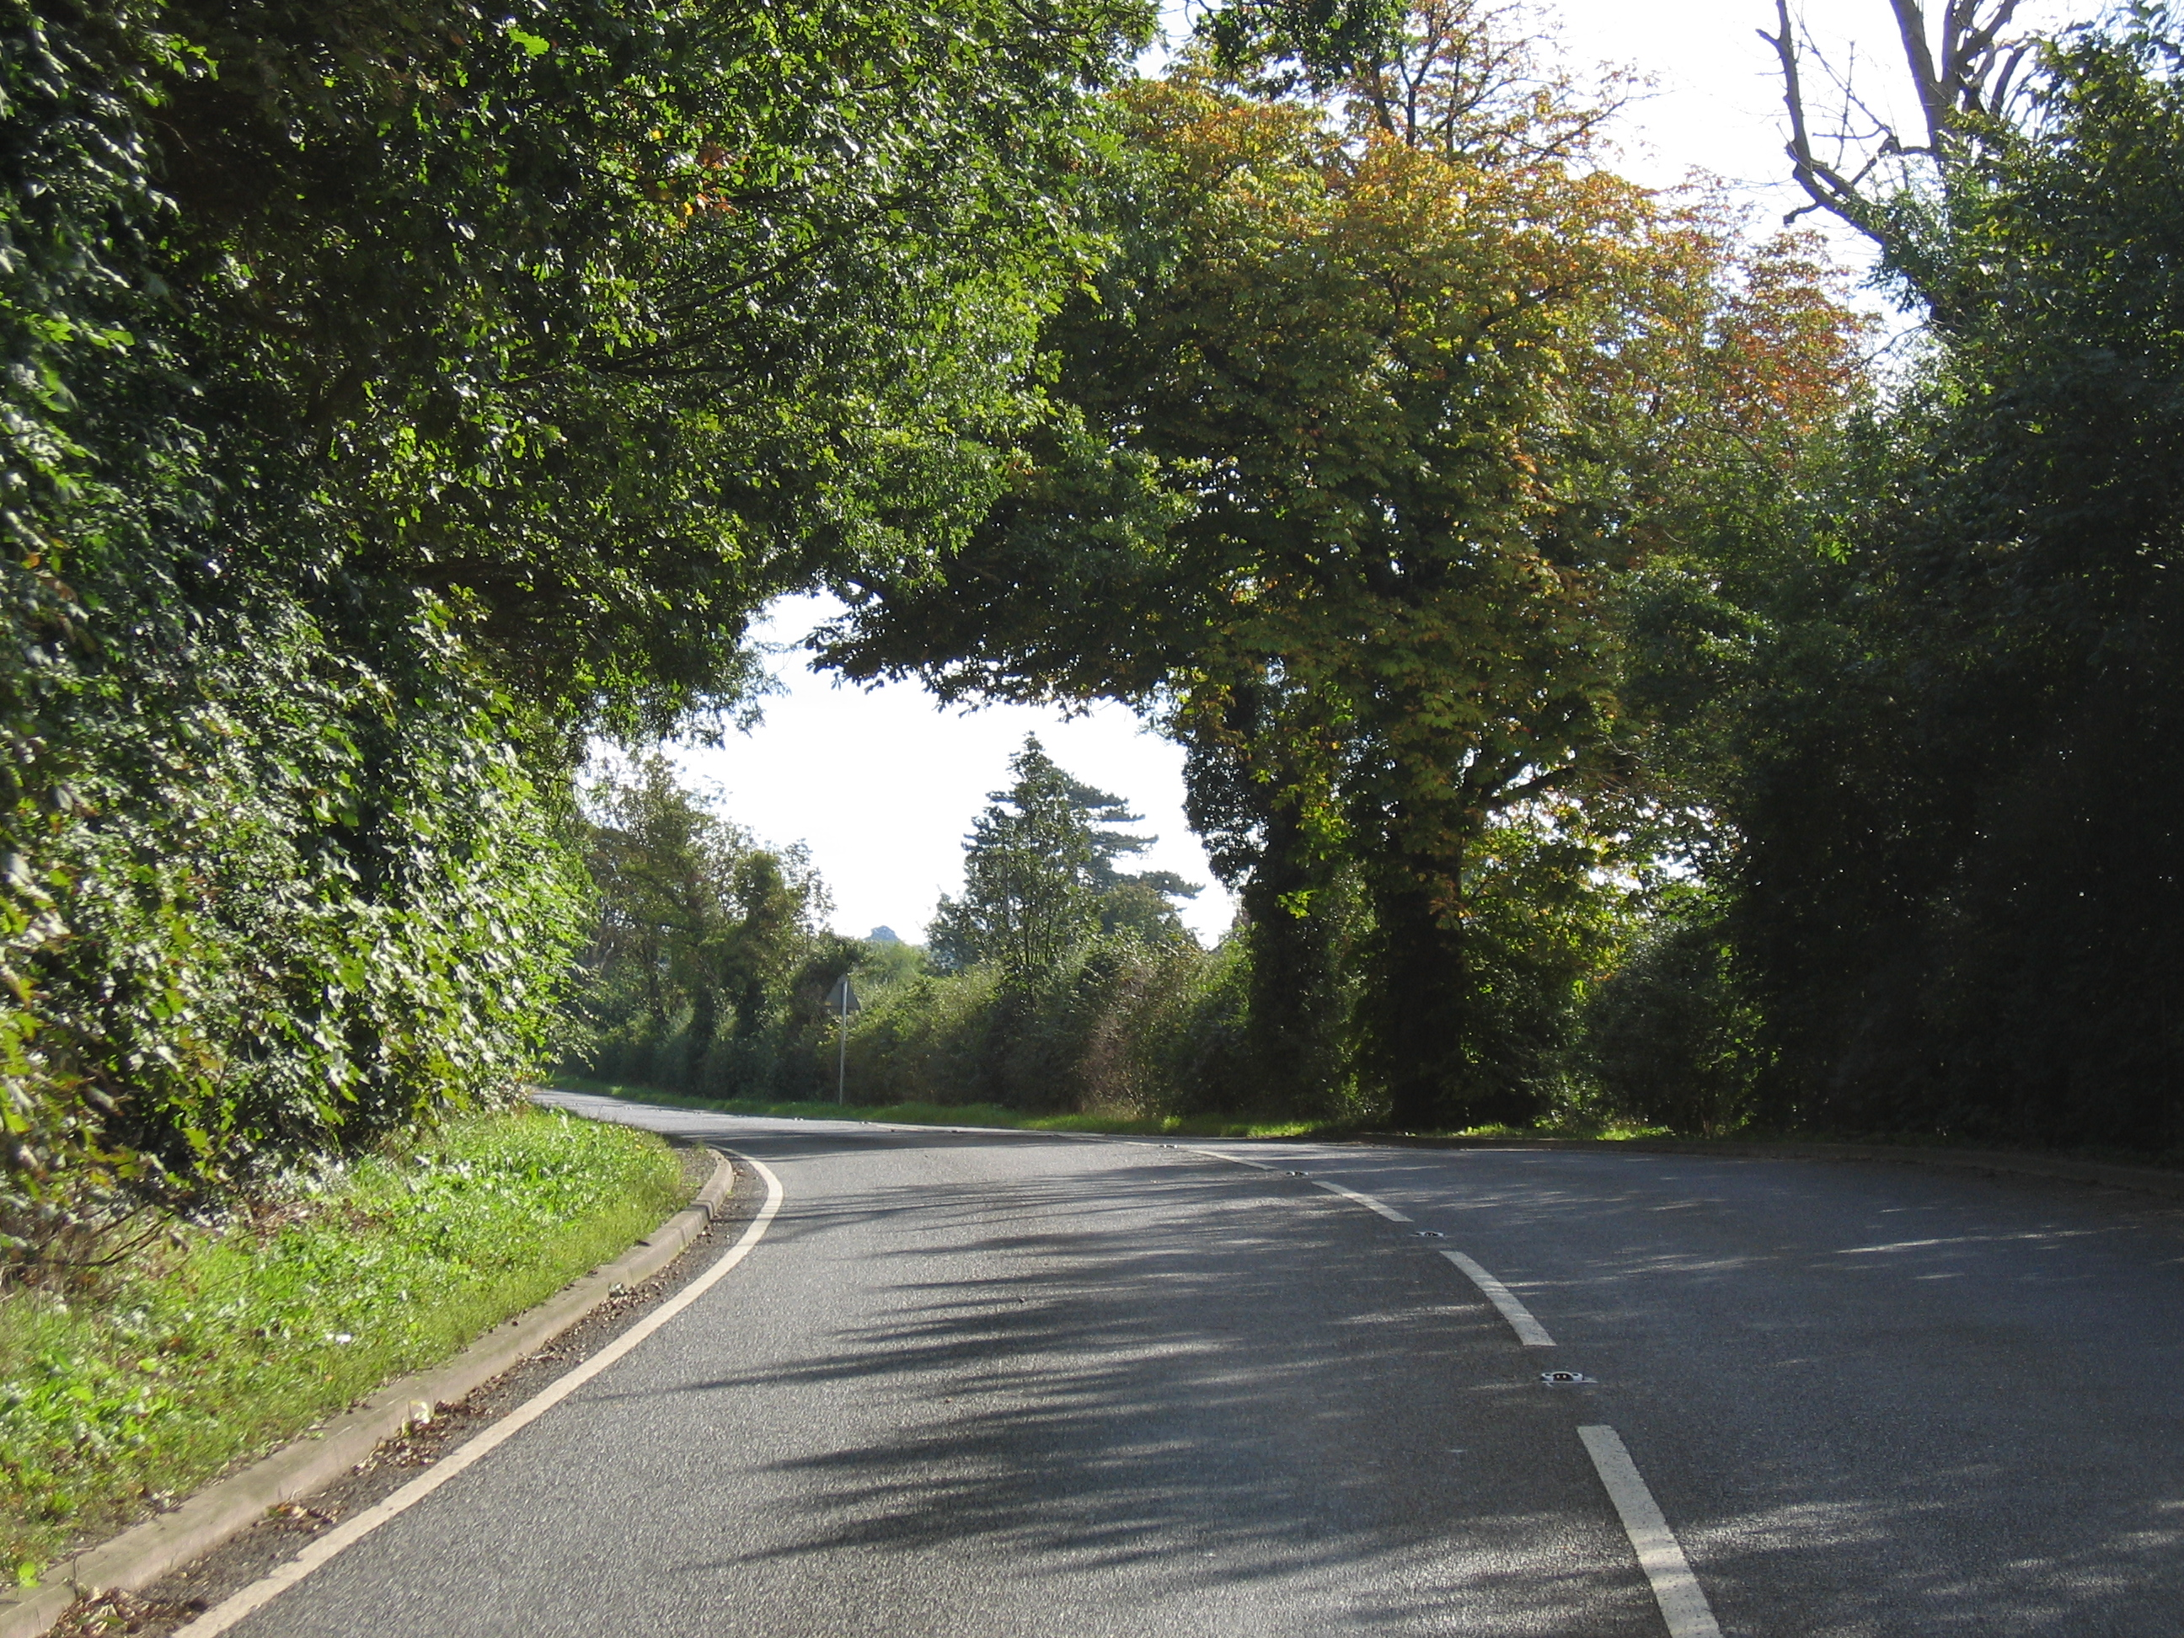
3 Right
Starting to accelerate at point 3 Right

Slide 75
4 Left
Have to wait until Point 4 left to accelerate

Slide 76
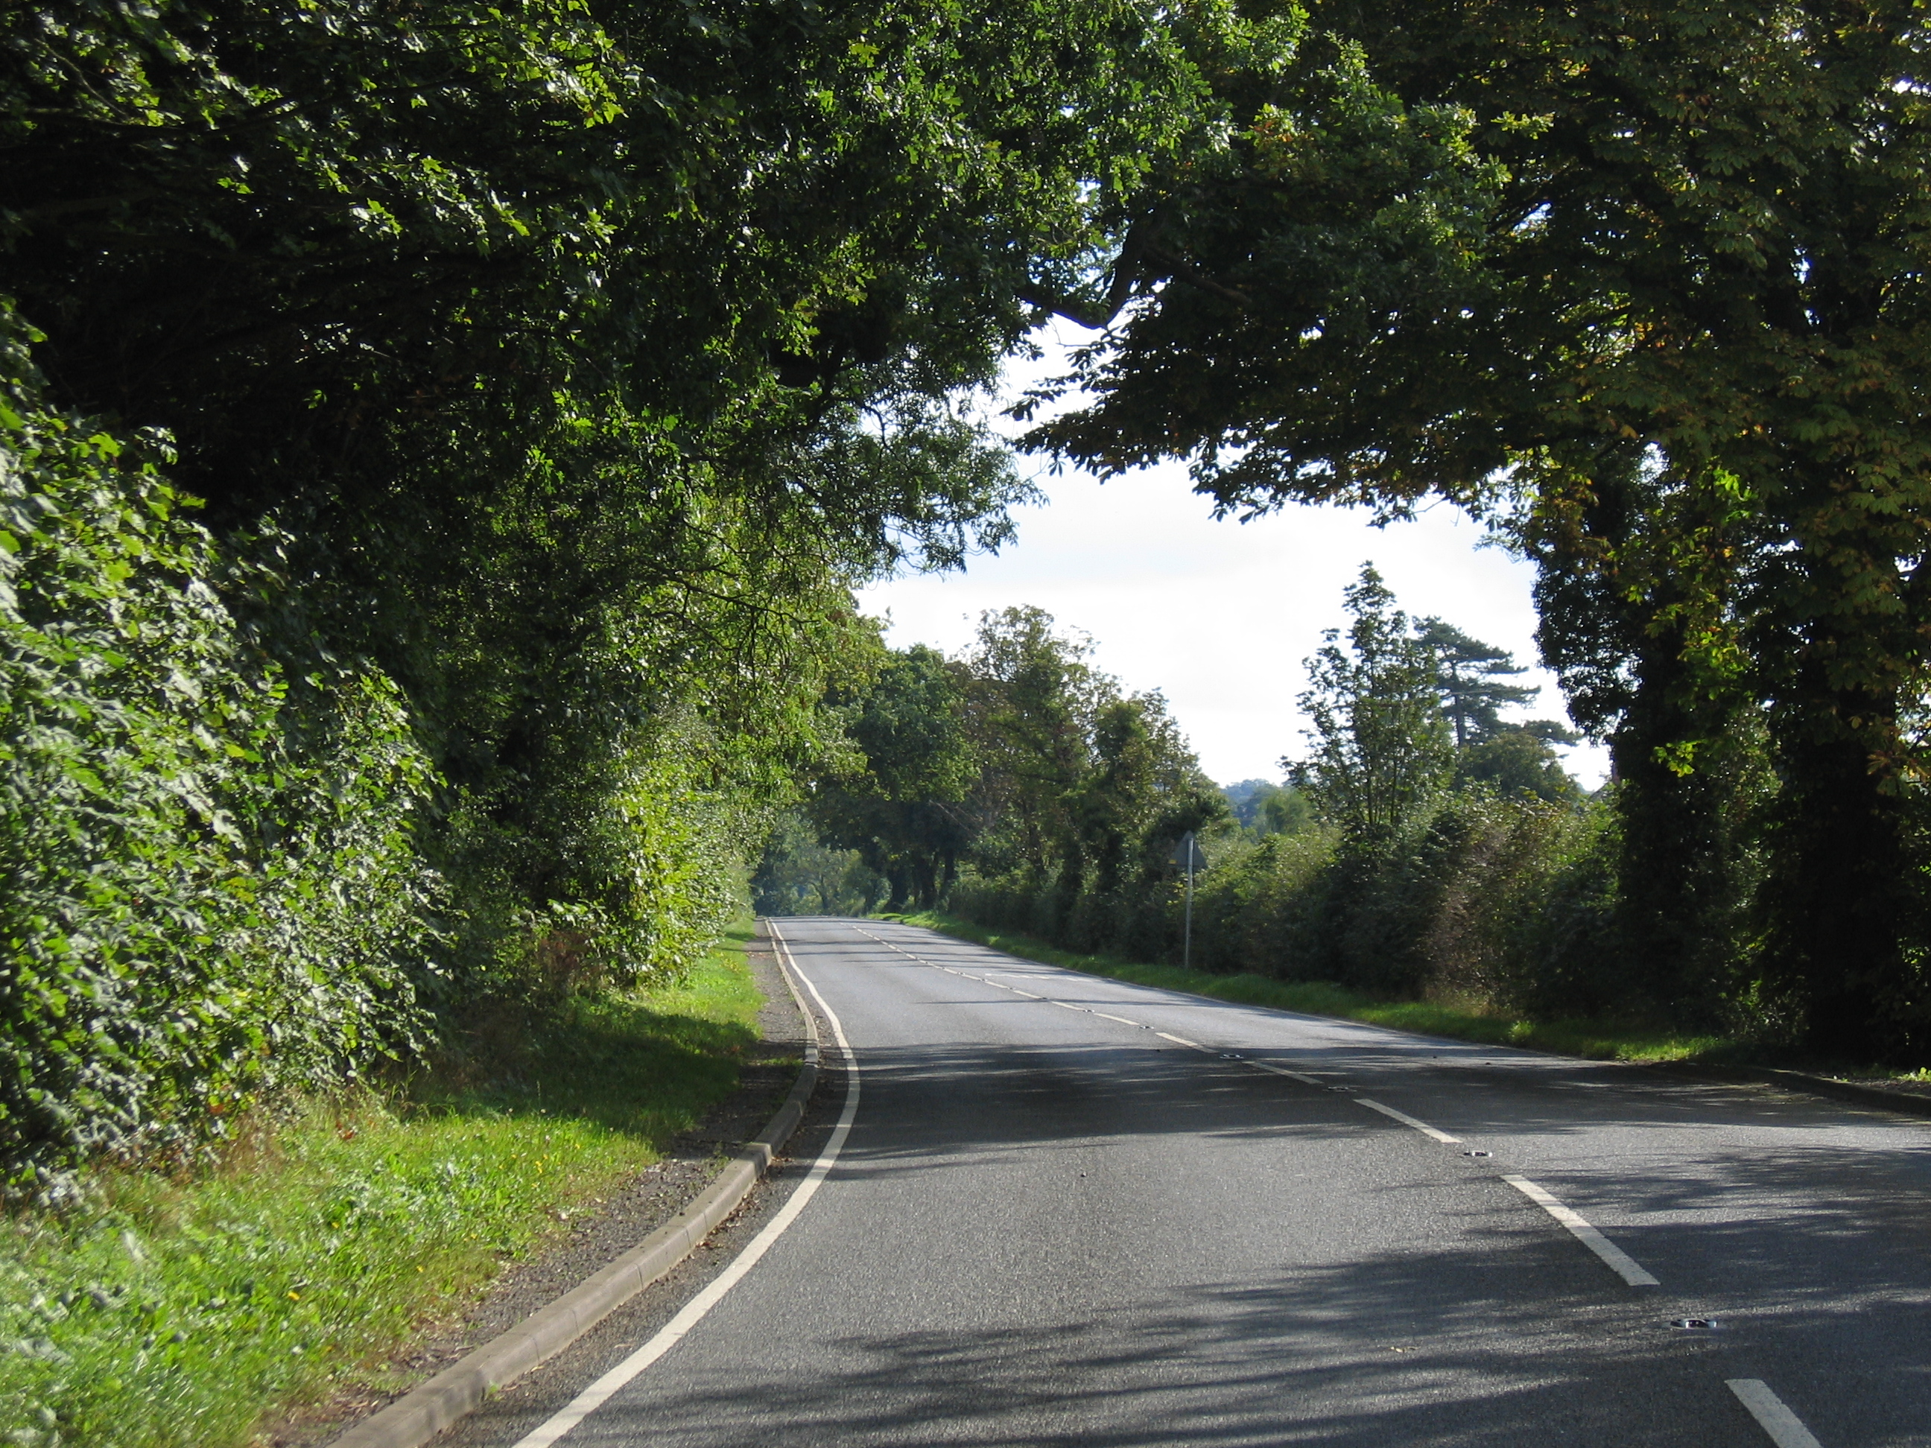
4 Right
Point 4 right we are on to the next hazard

Slide 77
So…
By keeping to the outside of corners
  Limit point is always further away
    (You can see further round)
    People can see you coming sooner
    You can keep speed higher going in to the corner
    The “Acceleration Point” occurs sooner
    You can accelerate out sooner

Slide 78
Commentary again
Try to mention a limit point somewhere – it sounds professional
Try and show him that you know distance/speed
Talk through one corner
Always use the Highway Code descriptions of road signs if you can
  All of the info
  Top down

Slide 79
Section 3
Of course you know about...
Skip

Slide 80
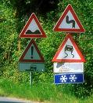
Uneven road
Warning of soft verge on right (unusual)
Double bend first to left
Slippery Road
?
Risk of ice or snowdrifts (unusual)

Slide 81

Hump in side road
Road narrows on right
Road works

Slide 82

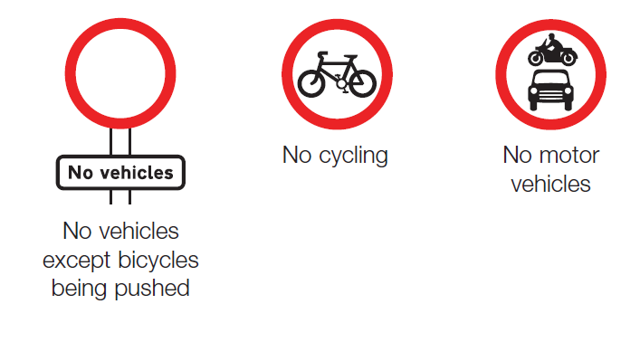
What is the difference?

Slide 83
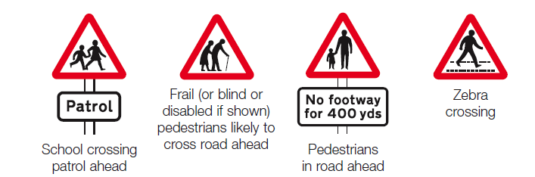
Often misused

Slide 84


Uneven Road
Humps

Slide 85


Slippery Road
There is something going-on ahead where lots of people have either crashed or fallen off of the road. So do not even think about claiming there was something wrong with the road because we have warned you and it is not our fault so there!

Slide 86
What they don’t tell you
Manoeuvres
Observers will do what they want unless you tell them differently
Take an active part in the test
Think about who the examiner is and what he wants to see

Slide 87
What else is there?
Police Class I
IAM Special Assessment
Plenty of room for you to improve yourself
An extremely intense workout of your driving skills. Wait a year. Get guidance and practice!
Police Class II
IAM Senior Observer
IAM Observer
ROSPA Gold
IAM Advanced
ROSPA Silver
ROSPA Bronze
DSA “L” test
Note – these are my unofficial comparisons , you cannot really compare these things in this way, and it is not my fault

Slide 88
Any Questions?
Notes:
88

Slide 89
Video

Slide 90
The end

Slide 91
http://www.users.globalnet.co.uk/~spoulton/iam_page.html

